Slide 1
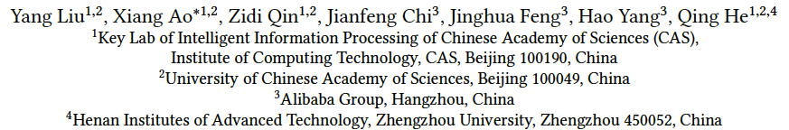
Pick and Choose: A GNN-based Imbalanced Learning Approach for Fraud Detection
Paper Authors:
Published Year: April 2021
Paper presented by Tieyun Zhang and Shuiliang Wu as CAS 747 Final
April 17th, 2023
Professor: Dr. Lingyang Chu
Notes:
Target: get this presentation as understandable as possible.

Slide 2
Content
Background
Algorithm of PC-GNN
Difficulty & Solutions
Experiments & Improvements
Conclusion & Comments

Slide 3




Background
Fraud
Opinion fraud (fake/spam review)
Financial fraud (fraudster/defaulter)
Fraud Detection
A set of processes and analyses that allow businesses to identify and prevent unauthorized financial activity
Graph-based Fraud Detection
Relational data could be modeled as a graph
R-U-R Reviews posted by the same User
R-S-R Reviews under the same product with the same Star rating
R-T-R Reviews under the same product in the same monTh
Images from https://www.gminsights.com/industry-analysis/fraud-detection-and-prevention-market
Notes:
The background of this work is fraud. Fraud is a serious crime that can negatively impact people’s life.
The author introduced opinion fraud (such as product review) and financial fraud as two examples.
Fraud detection plays an important role. Fraud detection and prevention market size is valued as USD 30 billion in 2022 and will reach over 250 billion dollars in 2032.
The paper is focused on graph based fraud detection. Graphs are used to model the relationship between the targets. For example for the product review sets, there are three relationships. RUR means they are posted by the same user. RSR means that they are under the same product with the same star rating and RTR means they are under the same product in the same month.

Slide 4
Background
Datasets
Public benchmark - Opinion fraud detection
YelpChi: hotel and restaurant reviews on Yelp
Amazon: product reviews under the
Musical Instrument category
Train/Valid/Test: 40%/20%/40%
Metrics
F1-macro: macroaverage of F1-score of each class
AUC: Area Under the ROC Curve
GMean: Geometric Meanof True Positive Rate (TPR) and True Negative Rate (TNR)
Notes:
The experiments on paper were conducted on two public benchmarks. For our work, we are only on the one benchmark - opinion fraud detection using datasets of yelpChi and amazon. The datasets for another benchmark is not available.

Slide 5
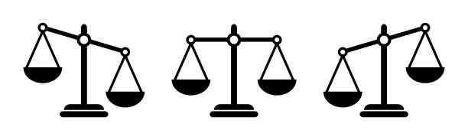
Background
Class Imbalance Problem
Only a small fraction of samples belong to the fraud class
The trained model is easily biased to the majority class
Challenges on Imbalanced Learning on Graphs
Camouflage:
redundant links between fraudsters and benign users
lack necessary links among fraudsters
GNN’s Message Aggregation:
Most neighbors belong to the majority class, the prediction would be biased
Minority class
Majority class
Notes:
No matter general fraud detection or graph based fraud detection, only a small number of samples belong to the fraud class. This is what is called the class imbalance problem. As a result of this, the trained model is easily biased to the majority class.
There are three challenges on imbalanced learning on graphs. The first two challenges come from the application phenomena named camouflage. Fraudsters will deliberately form many edges with the benign users to hide themselves which will cause redundant links between fraudsters and benign users. Secondly, fraudsters will avoid to form edges with another fraudster in order not to be discovered. This will cause the lack of necessary links among fraudsters. The last challenge comes from GNN’s message aggregation. If most neighbors belong to the majority class then the aggregated message may be dominated by the majority feature and the prediction could be biased to the majority class but the true class could be a minority class. This paper is to solve this class imbalance problem in graph based fraud detection.

Slide 6
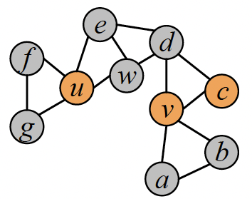
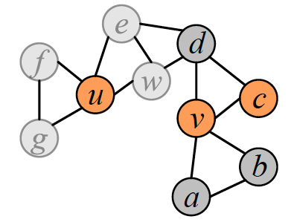
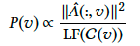
Algorithm of PC-GNN
Pick nodes from the whole graph for construction of a label balanced sub-graph
Label Frequency
Sampling Probability
LF( ) = 3
LF( ) = 6
P( ) = 1/3
P( ) = 1/6
Notes:
The solution from this paper is called PCGNN, let’s go through its algo.
The first step of PCGNN is to pick notes from the whole graph. In this simple demonstration example, in order to obtain a set of color balanced balls, one simple solution is to set the sampling probability to be inversely proportional to the label frequency. Similarly, for the node sampling in PCGNN, the probability of node v to be sampled should be inversely proportional to its label frequency so that the sub graph, shown in the right side, will be label balanced.

Slide 7
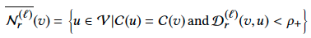
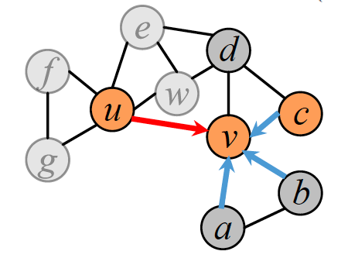
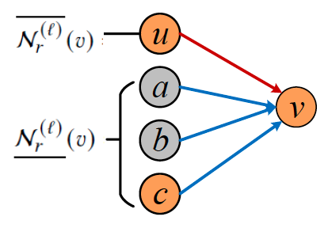
Algorithm of pC-GNN
Choose neighbors for each node
Over-sample neighbors of the minority class
Under-sample neighbors of the both classes
For minority targets:
For majority targets:
Notes:
The next step is to choose neighbors for each node. What they did is to over-sample neighbors of the minority class and under-sample neighbors of the both class. So they defined the over sampled neighborhood overline Nrlv to be the nodes who have the same label with the center node v and also have a closed distance to v. Meanwhile during under sampling, only those neighbors who have a close distance to v are chosen. The distance function was implemented by a MLP classifier to predict the label so it is a trainable function. So for the minority targets, neighborhood is defined to be the union of the under sample and over sample neighborhood. For the majority targets, only under sample neighborhood is used.

Slide 8
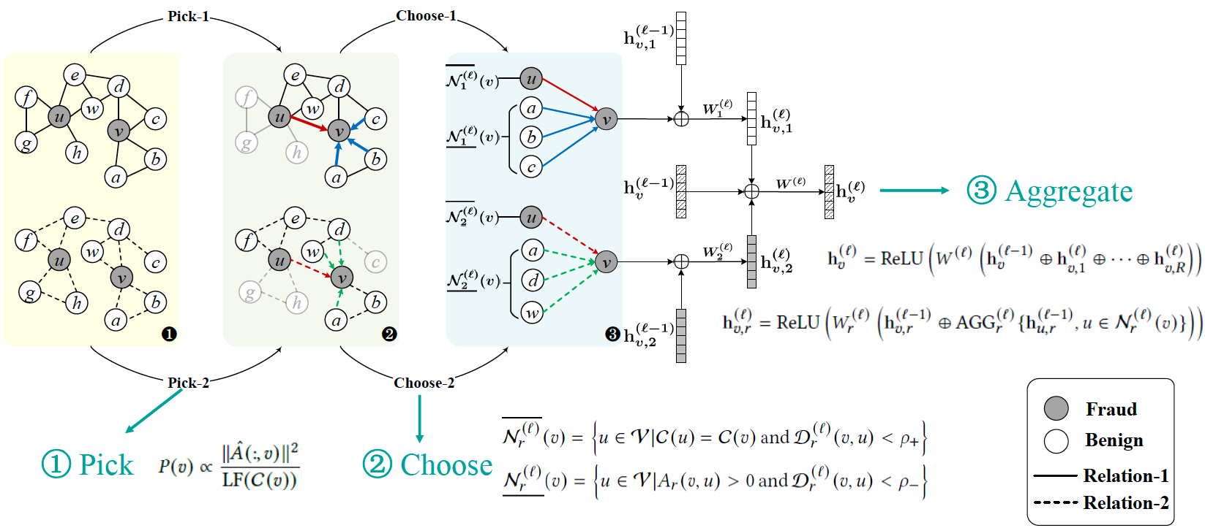
Algorithm of pC-GNN
PC-GNN: Pick and Choose Graph Neural Network
Notes:
As for the multi-relation sets, pick-and-choose process is performed for each relation. After message aggregation and concatenation, final representation hvl is obtained.

Slide 9
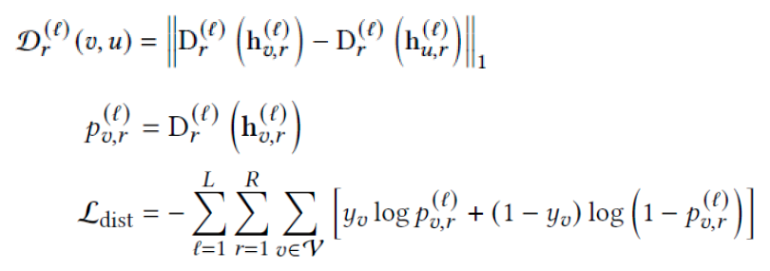
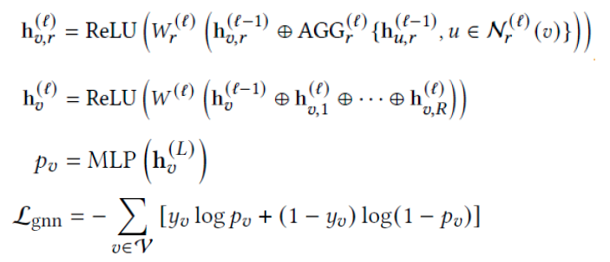
Algorithm of pC-GNN
PC-GNN: Training using the cross entropy loss
Training the distance function
Training GNN framework
Overall loss function
Notes:
The distance function and the GNN framework are both trained using the cross entropy loss and the overall loss is the sum of the both weighted by a parameter alfa

Slide 10
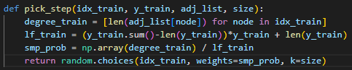
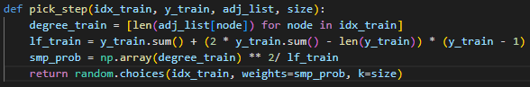
Difficulty & Solutions
1. Equation on Pick
LF( ) = 3
LF( ) = 6
P( ) = 1/3
P( ) = 1/6
Notes:
My first difficulty is the confusions on the author’s implementation of this equation as there are two discrepancies. The red one is that as per the function, sampling probability shall be squarely proportional to its degree so more attention can be paid to those important nodes in the graph. As we can see original one is set as linearly proportional. The second discrepancy lies on the implementation on the label frequency. What the paper said it to set 3 label frequency for minority and 6 for majority. What the author implemented is to set 3 for minority and 9 for majority. Don’t why so we set it to 6 and did some experiments.

Slide 11
Experiments & Improvements
Improvements on Pick
Summary of Experiment Results
Method | YelpChi |  |  | delta_AUC % | Amazon |  |  | delta_AUC %
 | F1-macro | AUC | Gmean |  | F1-macro | AUC | Gmean
Published Results | 0.6300 | 0.7987 | 0.7160 | / | 0.8956 | 0.9586 | 0.9030 | /
Re-run Results As the Baseline | 0.6850 | 0.8180 | 0.7234 | 2.41% | 0.8823 | 0.9666 | 0.9064 | 0.83%
Correction: degree_train ** 2 | 0.6047 | 0.7969 | 0.7207 | -3.02% | 0.8571 | 0.9487 | 0.8891 | -1.85%
New lf_train implementation | 0.6526 | 0.8217 | 0.7461 | 0.46% | 0.8827 | 0.9665 | 0.9050 | -0.01%
Optimization: degree_train ** k | 0.6680 | 0.8316 | 0.7531 | 1.67% | 0.8866 | 0.9672 | 0.9157 | 0.07%
Optimization on k
k | AUC
0.25 | 0.9647
0.50 | 0.9666
0.60 | 0.9672
0.65 | 0.9629
0.75 | 0.9636
1.00 | 0.9666
2.00 | 0.9487
Notes:
Here is the summary of the experiment results. We used the re-run results as the baseline as for unknow reason, published results are not as good as our re-run results.
Then, with it set to squarely proportional to degree, we see AUC drops for both datasets.
With our implementation of label frequency, AUC improves on Yelpchi.
We keep the new label frequency implementation, optimized the power to the degree, and we achieved 1.67% improvement to the baseline on Yelpchi. However There is not that much improvement on Amazon dataset.

Slide 12
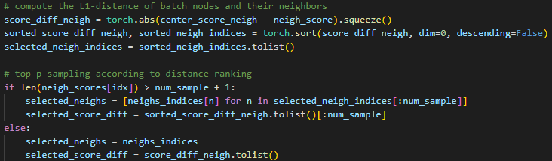
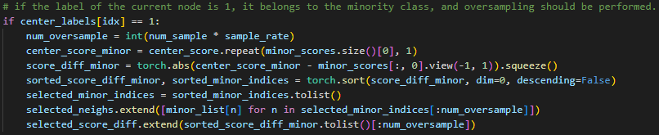
Difficulty & Solutions
2. How u was oversampled from author’s code implementation?
Under-sample neighbors of both classes
For majority targets:
Over-sample neighbors of the minority class
For minority targets:
Notes:
The second difficulty is to understand how u was oversampled from author’s code implementation for minority node V. All the neighbors to the center node from this code implementation are 1-hop neighbors as it is how the data was pre-processed and there are no multi-hop operations in the code. Later we realized that what pick step returned is a label balanced node set, rather than a label balanced graph so in the choose step, it simply appends those oversampled nodes to form the edges.

Slide 13
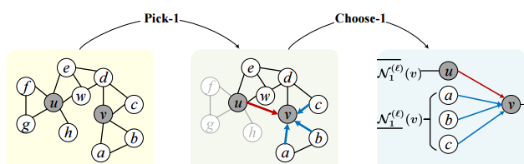
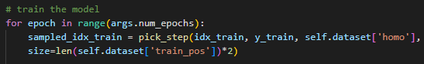
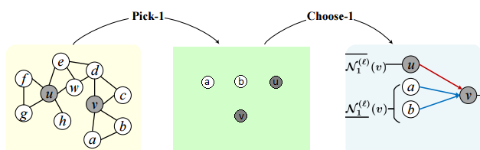
Experiments & Improvements
Correction on the paper demonstration figure
Paper’s Figure 2
Correction
Notes:
So there is misleading info from paper’s figure 2. Firstly, the number of nodes after pick step is twice as the total number of the minority class from the input. In this case, there shall be 4 nodes in total. Secondly, it is a set of label balanced nodes that is formed, rather than a label balanced graph. The graph construction is only happened in choose step.

Slide 14
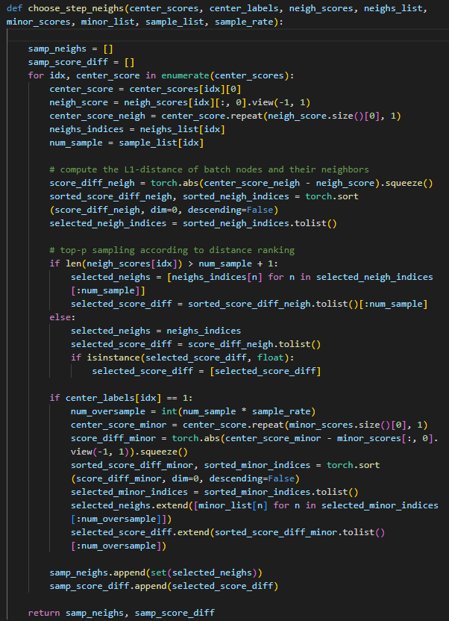
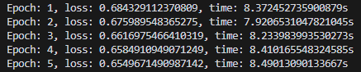
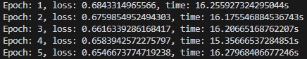
Difficulty & Solutions
3. Process speed: CPU > GPU ?
Processed by CPU
Processed by GPU
Reasons:
1. The for-loop is serial, so the pick and choose steps within a batch are not parallelized;
2. CPU is doing better job on serial computing
Notes:
The third confusion is why using CPU, the processing speed is faster than that using GPU? As we can see, it is almost twice faster.

Slide 15
Difficulty & Solutions
PC-GNN: Pick and Choose Graph Neural Network
Notes:
Let me introduce our understanding of the code implementation of the rest part and our improvements and results.
As for the aggregation process, there are two steps involved. Firstly it’s aggregating the choose nodes of each center node for each relationship. Secondly, aggregate the feature embeddings from each of the relations and combine them to finalize the aggregation.

Slide 16
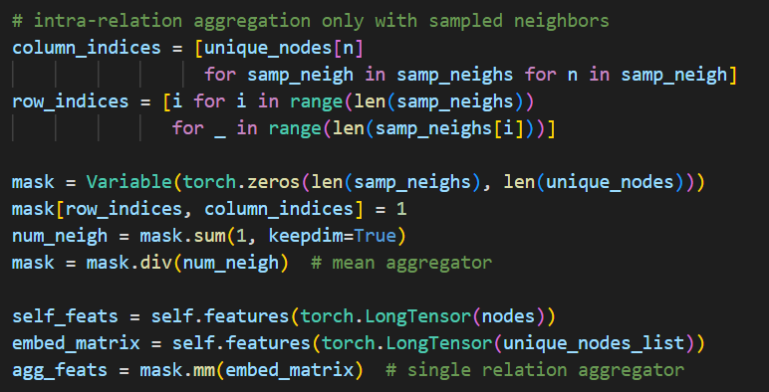
Difficulty & Solutions
PC-GNN: Code Implementation of Aggregation
Mean Aggregation
- Use mask as mean aggregator
Collect all the nodes and their selected neighbors to indices lists
Mark the adjacency with 1’s in the mask matrix
Count the number of neighbors and divide 1’s with the numbers
Multiply the mask with the embeddings of the neighbors
Notes:
For the aggregation within a relationship, it’s implemented using mean aggregation. The code used a mask to calculate the weight for each selected neighbor.
It works as follows:
- Collect all the nodes and their selected neighbors to indices lists
Mark the adjacency with 1’s in the mask matrix
Count the number of neighbors and divide 1’s with the numbers
Multiply the mask with the embeddings of the neighbors

Slide 17
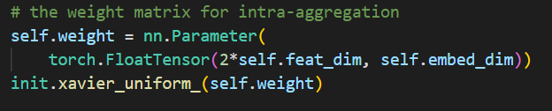
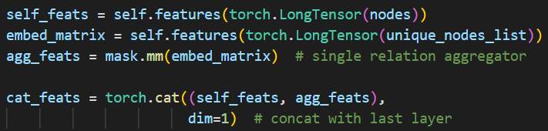
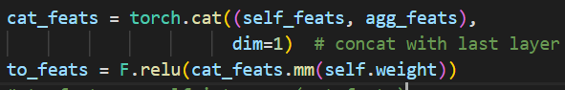
Difficulty & Solutions
PC-GNN: Code Implementation of Aggregation
Concatenation
- Use weighted matrix to encode
- Register weighted matrix as model’s parameter
- Concatenate self-feature and aggregated feature
- Multiply the concatenated feature with the weighted matrix
Notes:
The code used a weighted matrix to combine the aggregated embeddings to the previous embeddings, which is a common practice. We have tried to substitute the weight matrix with MLP layers, and results will be presented later.

Slide 18
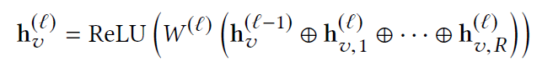
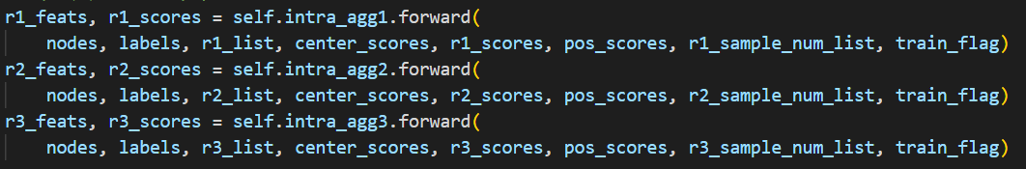
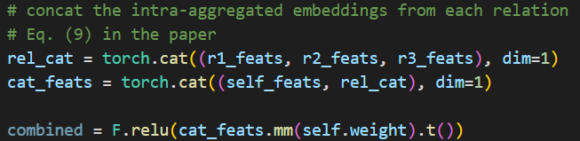
Difficulty & Solutions
PC-GNN: Code Implementation of Aggregation
Cat Aggregation
Aggregate features of each relationship recursively
Concatenate the aggregated features from the three relationships
Multiply by weighted matrix to encode
Notes:
After aggregating the embeddings from the three relations recursively, they used concatenating aggregation and combined them together using a weight matrix, which we also substituted with an MLP.

Slide 19
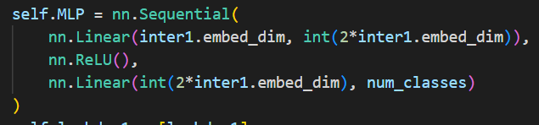
EXPERIMENT - improvement
Substitute weighted matrix with MLP
The impact of the MLP on different positions:
Pros:
More non-linearity
Better representation learning ability
More flexibility
Cons:
More difficult to train
Positions to use MLP | AUC on YelpChi | AUC on Amazon
Baseline | 83.11 | 97.18
IntraAgg | 82.14 | 96.73
InterAgg | 83.55 | 96.98
IntraAgg+InterAgg | 83.15 | 96.76
InterAgg+model output | 84.15 | 96.91
The size of the hidden lays is adjustable
Notes:
While the weighted matrix introduced non-linearity into the model, a MLP can even enhance the non-linearity and representation learning ability. Also more flexible, the size of hidden lay can be adjusted easily.
We have implemented an MLP as shown in the picture below to substitute the original implementation above.
After trying different positions to substitute the weight matrix with our MLP, we found the best combination, which is substituting the weighted matrix in InterAgg and model output.
However, this substitution didn’t improve the performance of the model on amazon dataset. SOTA research on amazon only reached 96.29 on AUC metrics.

Slide 20
EXPERIMENT - improvement
Substitute weighted matrix with MLP
The impact of the size of hidden layer of MLP
Pros:
More non-linearity
Better representation learning ability
More flexibility
Cons:
More difficult to train
Positions to use MLP | AUC on YelpChi
2x input size | 84.15
1.5x input size | 83.72
0.7x input size | 82.05
2.5x input size | 83.23
Baseline | 83.11
The size of the hidden lays is adjustable
Notes:
The size of the hidden layer of the MLP is a critical hyperparameter. We have fine-tuned the size of it and got the best result.

Slide 21
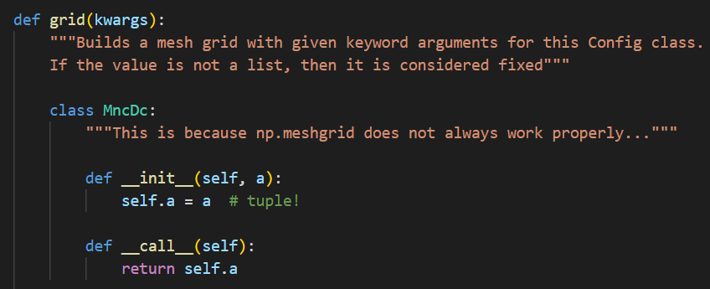
EXPERIMENT - improvement
Hyper-parameter tuning
Comparison between our finetuned results and the paper’s
Support of Multi-run:
Tuned Parameters | Best combination
Sample rate | 0.2
Batchsize | 1024
Alpha | 0.8
Metrics | Dataset | Result on Paper | Ours
AUC | Yelp | 79.87 | 83.11
 | Amazon | 95.86 | 97.18
F1 Macro | Yelp | 63.00 | 70.39
 | Amazon | 89.56 | 87.75
GMean | Yelp | 71.60 | 70.51
 | Amazon | 90.30 | 90.94
Notes:
The are multiple tunable parameters.
We tuned three hyper-parameters to get the best result. The code implementation will run on all the permutations of each given hyper-parameters and present the best combination of them.
Sample rate affects the number of oversampling nodes, batch size is the size of the the subgraph. Alpha is the weight in the loss function.
Here is the result. We can see an obvious improvement compared to the original result on the paper.

Slide 22
EXPERIMENT – Final Result
Notes:
These are our best result after hyper-parameter tuning and MLP substitution compared to the result in the paper. We can see a nearly 4 percent enhancement on yelp dataset and 1.5 percent improvement on Amazon.

Slide 23
Conclusion & comments
Conclusion
We studied a GNN-based imbalanced learning method named PC-GNN to solve the class imbalance problem in graph-based fraud detection. The Pick-and-Choose is a simple but effective way to solve the imbalanced label issue.
We investigated the Pick-and-Choose method in depth, clarified two incoherence of the paper and the code implementation.
We improved the performance by tuning hyper-parameter and adding MLP
Thanks

